Slide 1
Introduction to MPEG-2 Compression
Introduction to MPEG-2 Compression

Slide 2
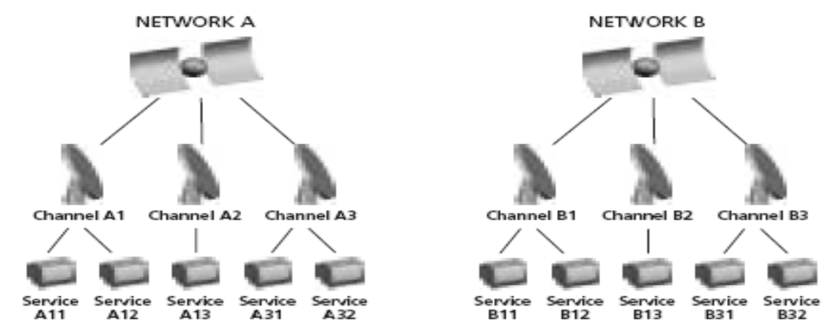
Broadcast Networks
The USA FCC allocated three bands of frequencies in the radio spectrum , chopped into 6-MHz slices, to accommodate these TV channels:
54 to 88 MHz for Channels 2 to 6 (VHF)
174 to 216 MHz for Channels 7 through 13 (very high VHF)
470 to 890 MHz for Channels 14 through 83 (UHF)

Slide 3
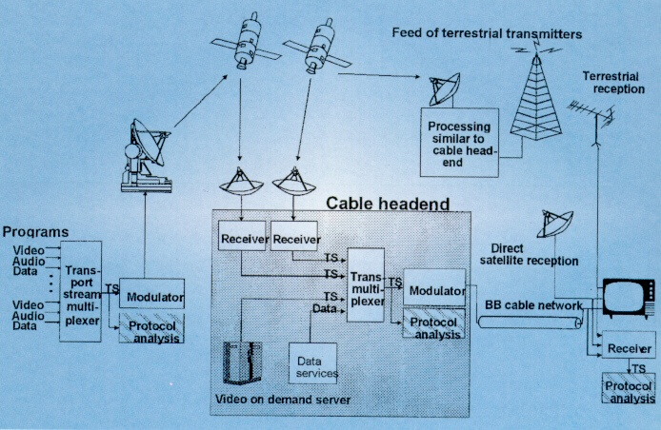

Slide 4
Broadcast Channels
Each broadcaster has one digital TV channel, but one channel can carry multiple sub-channels if the broadcaster chooses that option. Here's how it works:
On its digital channel, each broadcaster sends a 19.39-megabit-per-second (Mbps) stream of digital data. Broadcasters have the ability to use this stream in several different ways.
For example:
A broadcaster can send a single program at 19.39 Mbps.
A broadcaster can divide the channel into several different streams (perhaps four streams of 4.85 Mbps each). These streams are called sub-channels. For example, if the digital TV channel is channel 53, then 53.1, 53.2 and 53.3 could be three sub-channels on that channel. Each sub-channel can carry a different program.

Slide 5
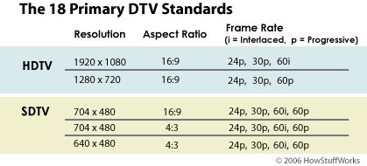
DTV, SDTV, HDTV
The Advanced Television Standards Committee (ATSC) has set voluntary standards for digital television. These standards include how sound and video are encoded and transmitted.
The ATSC has created 18 commonly used digital broadcast formats for video.
Formats
The reason that broadcasters can create sub-channels is because digital TV standards allow several different formats. Broadcasters can choose between these formats:
Notes:
MPEG/DVB Overview
Tektronix

Slide 6
ATSC 18 formats
.
spec | Horizontal pixels | Vertical pixels |  | Aspect ratio | Monitor interface | Format name | Frames per sec | Fields per sec | Transmitted interlaced
ATSC | 1920 | 1080 |  | 16:9 | 1080i | 1080 60i | 30 | 60 | yes
 |  |  |  |  |  | 1080 30p | 30 | 30 | no
 |  |  |  |  |  | 1080 24p | 24 | 24 | no
 | 1280 | 720 |  | 16:9 | 720p | 720 60p | 60 | 60 | no
 |  |  |  |  |  | 720 30p | 30 | 30 | no
 |  |  |  |  |  | 720 24p | 24 | 24 | no
 | 704 | 480 |  | 16:9 | 480p | 480 60p | 60 | 60 | no
 |  |  |  |  | 480i | 480 60i | 30 | 60 | yes
 |  |  |  |  |  | 480 30p | 30 | 30 | no
 |  |  |  |  |  | 480 24p | 24 | 24 | no
 | 704 | 480 |  | 4:3 | 480p | 480 60p | 60 | 60 | no
 |  |  |  |  | 480i | 480 60i | 30 | 60 | yes
 |  |  |  |  |  | 480 30p | 30 | 30 | no
 |  |  |  |  |  | 480 24p | 24 | 24 | no
 | 640 | 480 |  | 4:3 | 480p | 480 60p | 60 | 60 | no
 |  |  |  |  | 480i | 480 60i | 30 | 60 | yes
 |  |  |  |  |  | 480 30p | 30 | 30 | no
 |  |  |  |  |  | 480 24p | 24 | 24 | no
NTSC | ≈640 | 483 |  | 4:3 | Note 1 | NTSC | 30 | 60 | yes
Note 1: Some people refer to NTSC as 480i

Slide 7
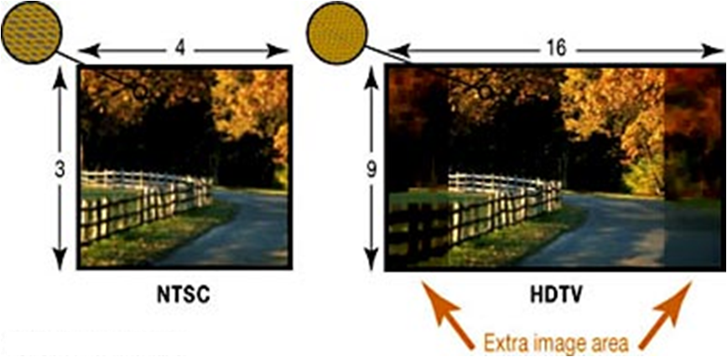
Aspect Ratio
The HD formats of digital TV have a different aspect ratio than analog TVs.
An analog TV has a 4:3 aspect ratio.

Slide 8
MPEG-2 Compression and Transport stream
ES=Elementary Stream
Containing Access Units I,B,P
Timing DTS/PTS
Programme Specific Information(PSI) or
Service Information (SI)
Data
Zee Cinema
M
U
L
T
I
P
LEXER
System Time Clock
(STC)
ES
F
R
O
N
T
E
N
D
Video
Encoder
Packetiser
PES
M
O
D
U
L
A
T
O
R
D
A
C
Data
Packetiser
PES
Audio
Encoder
ES
PES
MPEG-2 Transport
Stream
Packetiser
Zee news
Video
Encoder
ES
Packetiser
PES
Data
Packetiser
PES
Audio
Encoder
ES
Packetiser
PES
DVB
ATSC
ISDB
MPEG Compression Layer
Carrier Freq
MPEG Systems Layer+ DVB/ATSC/ARIB
QPSK , OFDM
QAM ,HM
8VSB

Slide 9
Creating a Transport Stream
Elementary Stream (ES)
Once a video or audio stream is compressed, it becomes an Elementary Stream (ES).
The elementary stream is a continual stream of encoded video frames (I, B, P frames). Though all the data required to reconstruct frames exists here.
No timing information or systems data is contained.
Packetisation of an elementary stream to yield a packetized elementary stream (PES)

Slide 10
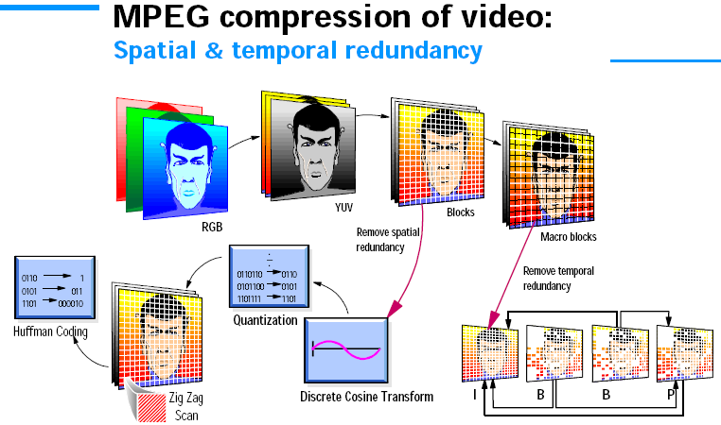
MPEG-2 Video Compression

Slide 11
Spatial encoding and temporal encoding
There are two main types of MPEG video compression
Spatial encoding and Temporal encoding.
Spatial encoding eliminates redundancy between adjacent pixels in a video frame.
Temporal encoding minimizes redundancy between the frames in a video sequence.
Spatial encoding :
Spatial encoding relies on similarities between adjacent sets of pixels in plain areas of a picture. For instance, a picture that contains a blue-sky background will likely contain several rows of identical blue pixels.
Spatial encoding can code only one set of these pixels and then indicate that the rest are identical, thus eliminating redundant data from the bit stream.
Temporal encoding :
Temporal encoding eliminates redundancy between sequential frames in the video stream.
Temporal coding takes advantage of the similarities between sequential frames and encodes only the differences from one frame to the next.

Slide 12
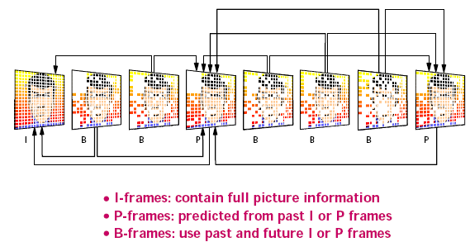
I, B, P frames

Slide 13


